Slide 1


The Open Innovation Hackathon Challenge
KUPPAM ENGINEERING COLLEGE
Approved by AICTE, NEW DELHI,
Affiliated to JNTUA University,
An ISO 9001:2008 Certified Institution
DEPARTMENT OF ELECTRONICS AND COMMUNICATION ENGINEERING
PROJECT TITLE : sensor technologies for soil fertility and monitoring
Team Name: Multiple Scorgasms

Slide 2
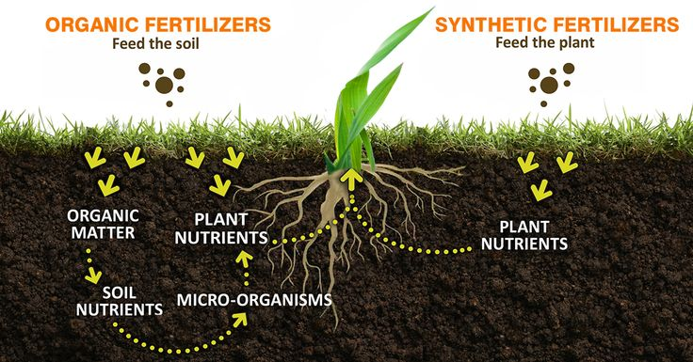

Sensor technologies for soil fertility and monitoring
There are many problems faced by the farmers, one of the problem is to find the fertility of the soil. Farmer by themselves cannot find the fertility of soil and don’t know how much quantity of fertilizers to be added for better crop growth.

Slide 3
Block diagram of the device
Power supply
Mobile App
N P K Sensors
Micro Controller
PH Sensor
LCD Display
Soil Mositure
Arudino
temperature

Slide 4
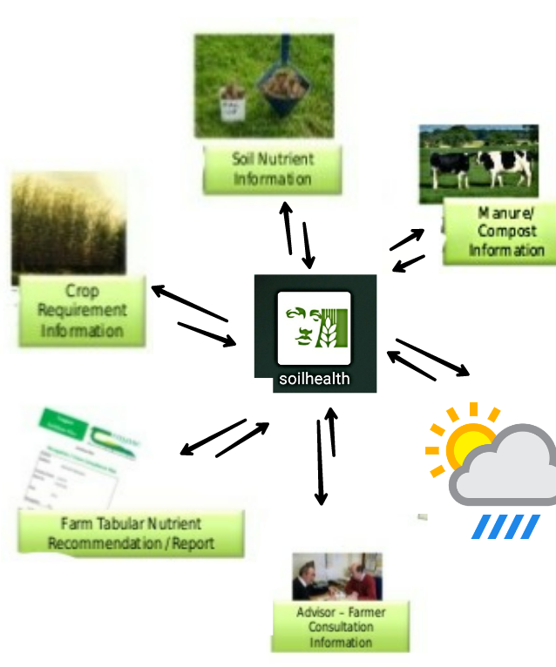
Content of our APP

Slide 5
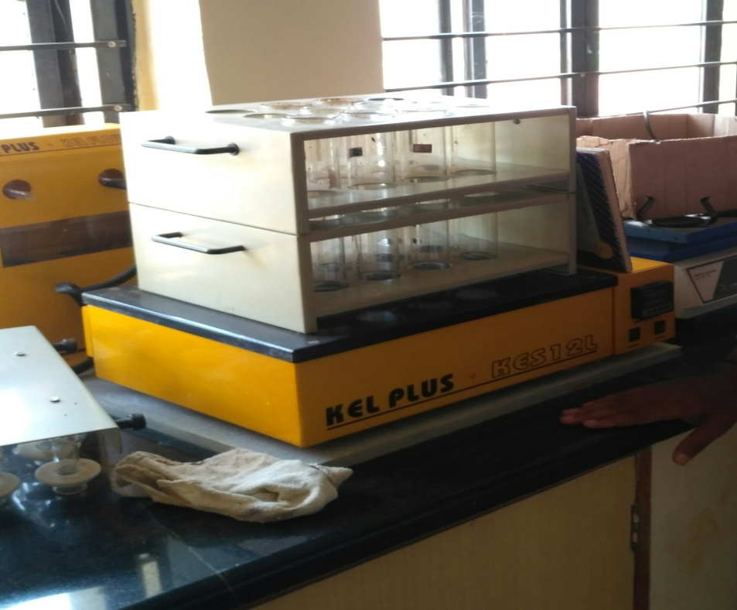
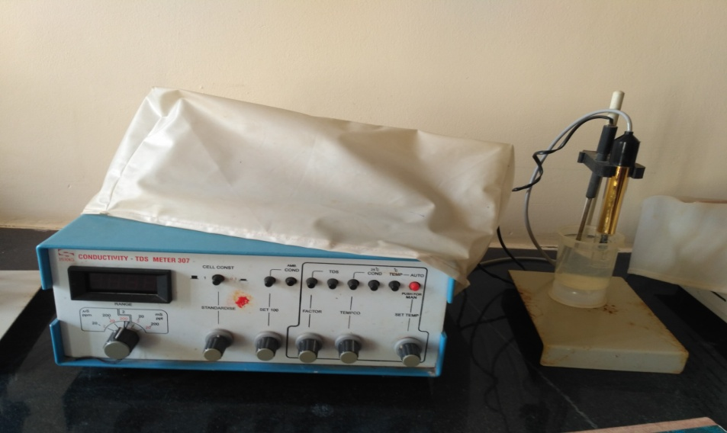
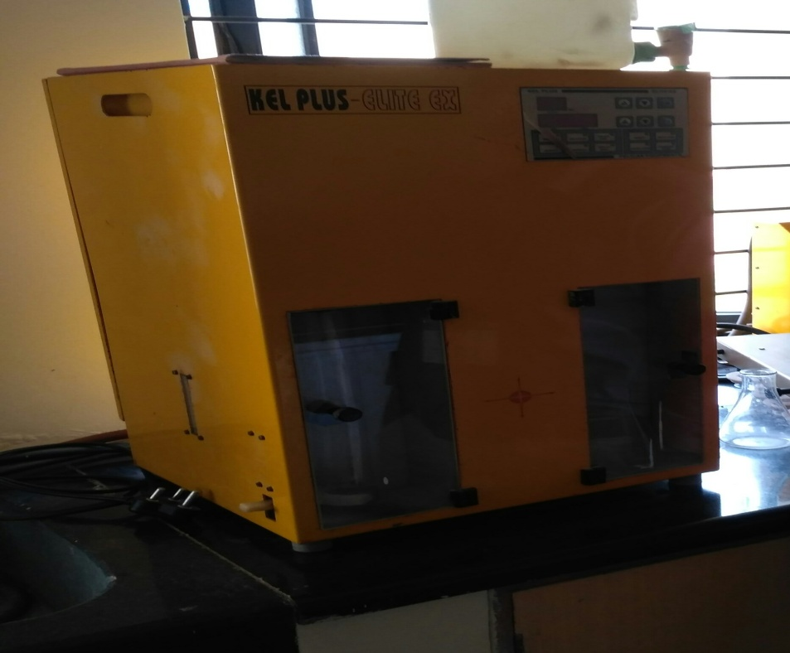
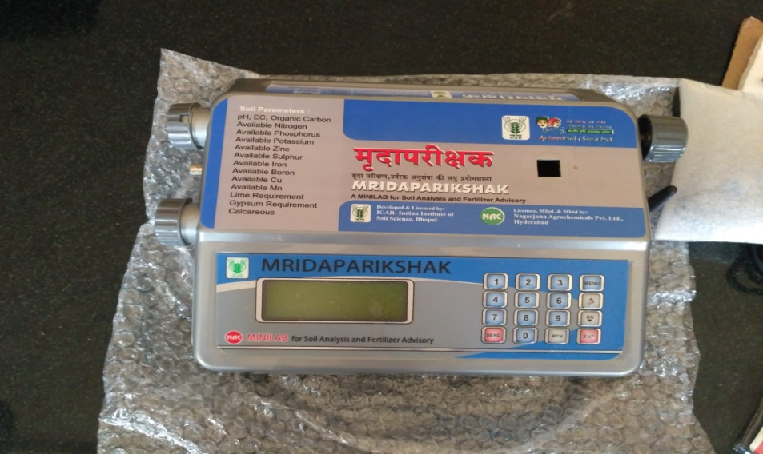
Traditional Equipments

Slide 6
Business Model
Relationship
Product providing in a less cost and more affordable to use
Resource
Arudino , sensors companies , coding, man power
Value creation
Customers
Product which shows the fertility of the soil
Activities
Farmers income is our main goal.
gathering the components , assembling , coding , testing , final testing, packing
Partners
Bulk production,servers, advertisement
Distribution
Shareholders , sources companies
Media, government help , marketing by fertilizer companies
Values capture

Slide 7
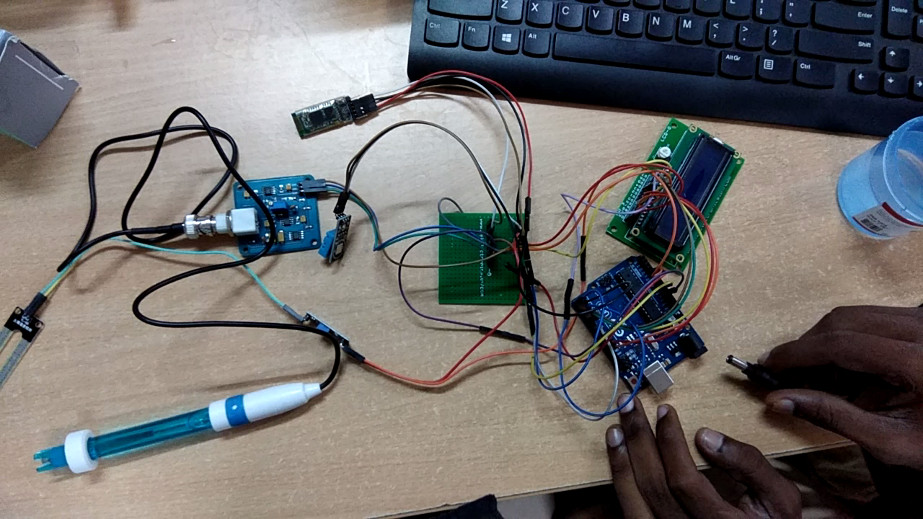

Slide 8

Conclusion
As it’s very big deal by the government
to send the officers for testing soils.
But by our project farmers themselves
can check their lands fertility, we are
also helping the farmers in finding the
natural fertilisers to increase growth.
Thank You

